Slide 1
AWS(SERVICES)
PREPARED BY:
S M AALIM HUSSAIN (DS-037/2022)

Slide 2
Spotify Dataset 2023 (kaggle.com)
https://www.kaggle.com/datasets/tonygordonjr/spotify-dataset-2023

Slide 3
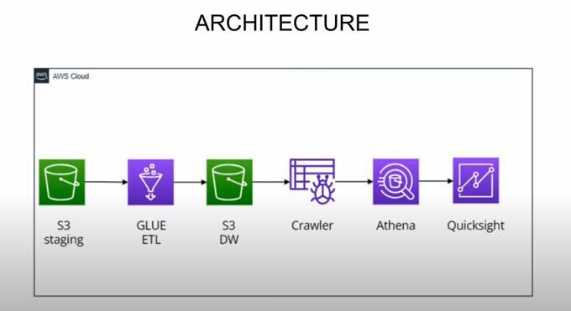

Slide 4
IAM USER

Slide 5
An AWS Identity and Access Management (IAM) user is an entity that you create in AWS. The IAM user represents the human user or workload who uses the IAM user to interact with AWS. A user in AWS consists of a name and credentials.

Slide 6
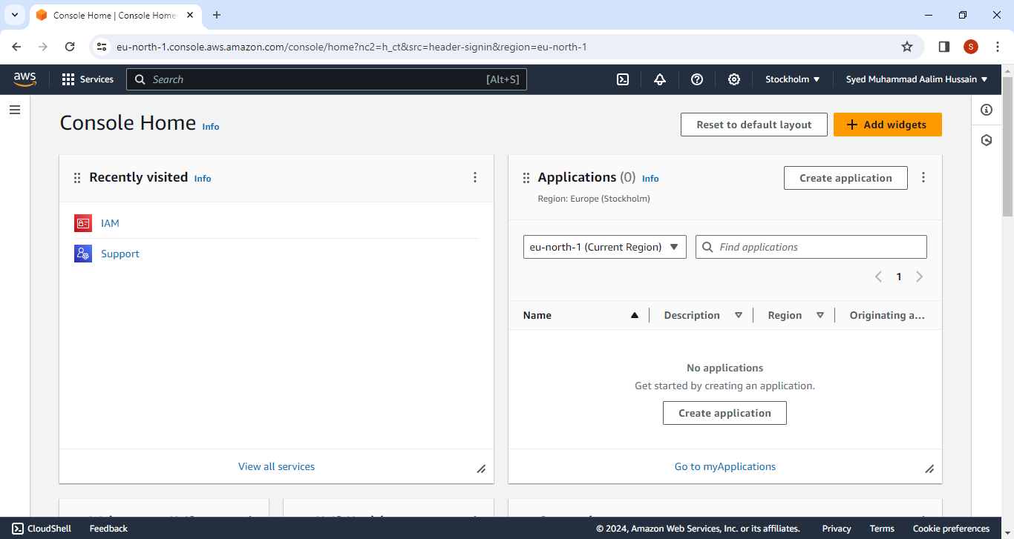

Slide 7
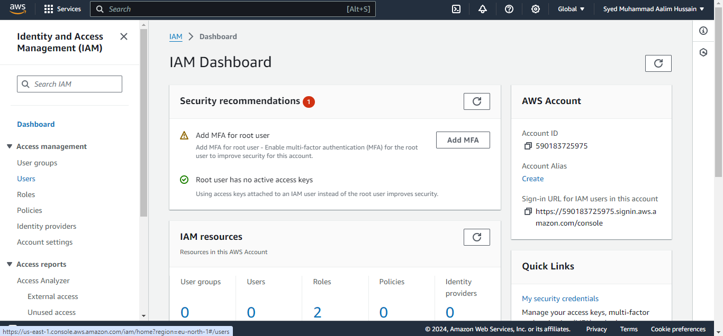

Slide 8
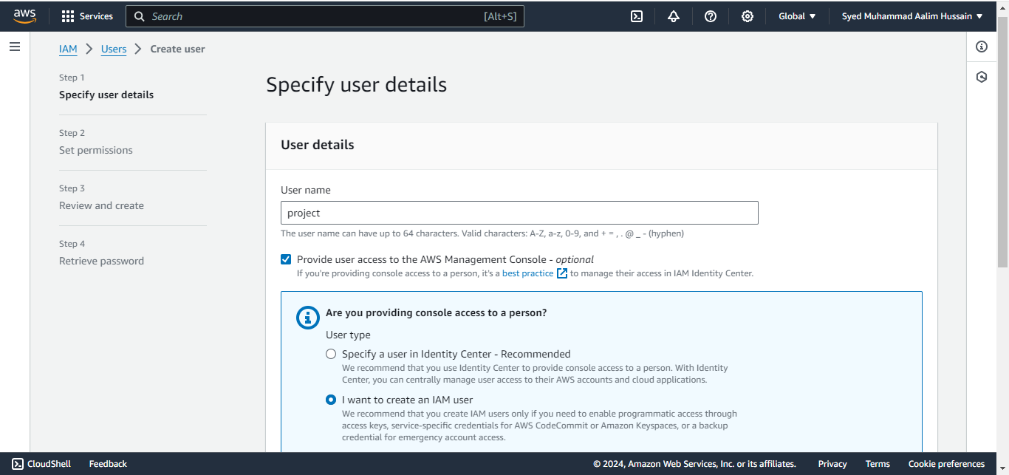

Slide 9
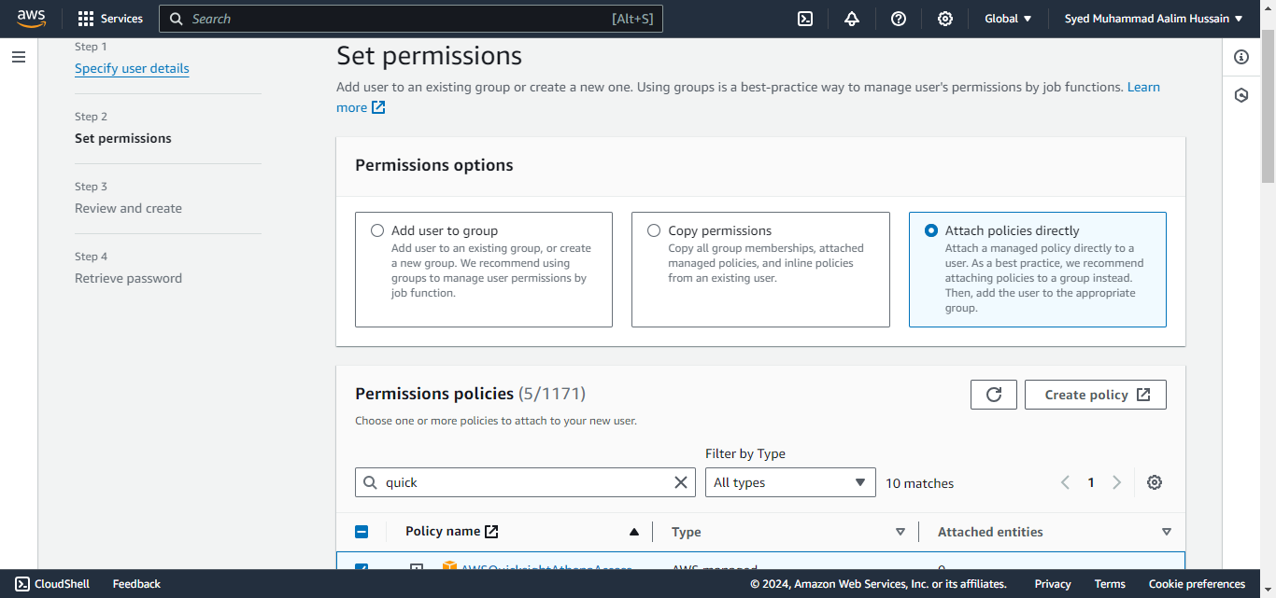

Slide 10
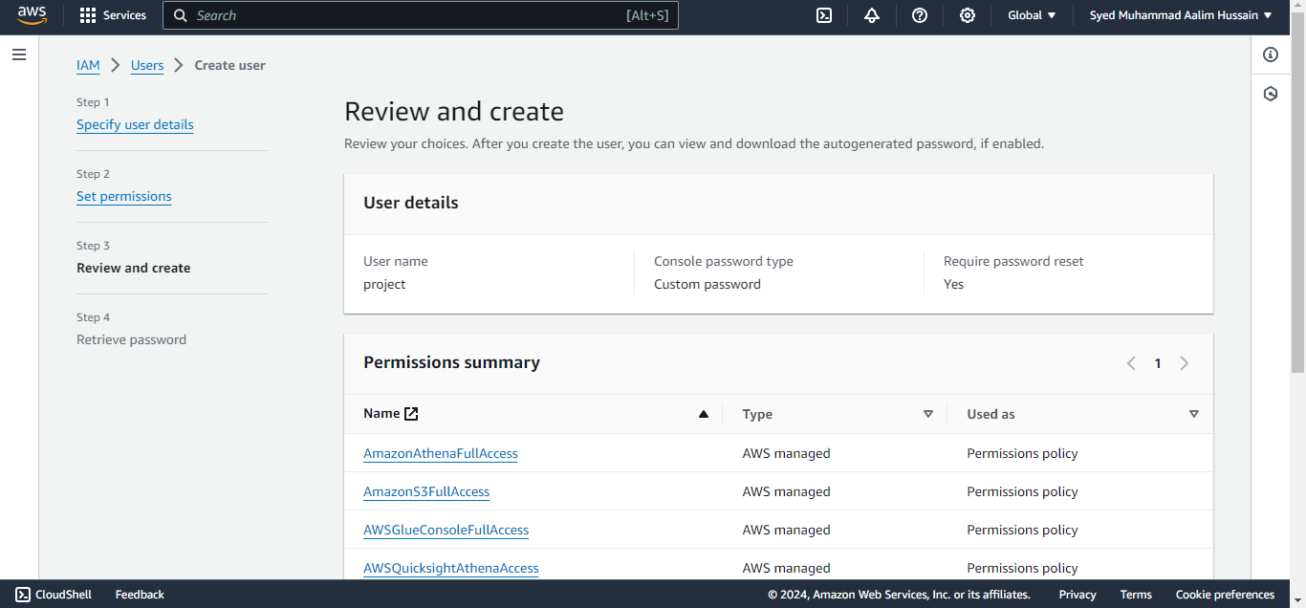

Slide 11
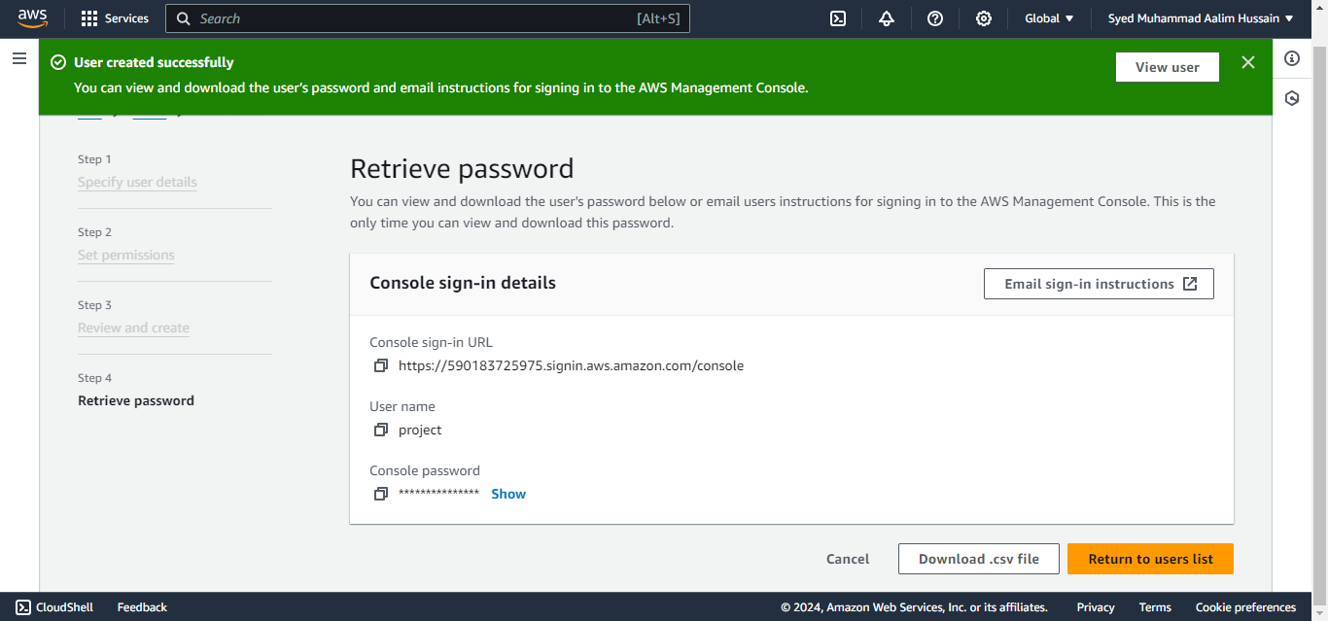

Slide 12
Console sign-in details
Console sign-in URL
https://590183725975.signin.aws.amazon.com/console
User name
project
Console password
datawarehouseA1..

Slide 13
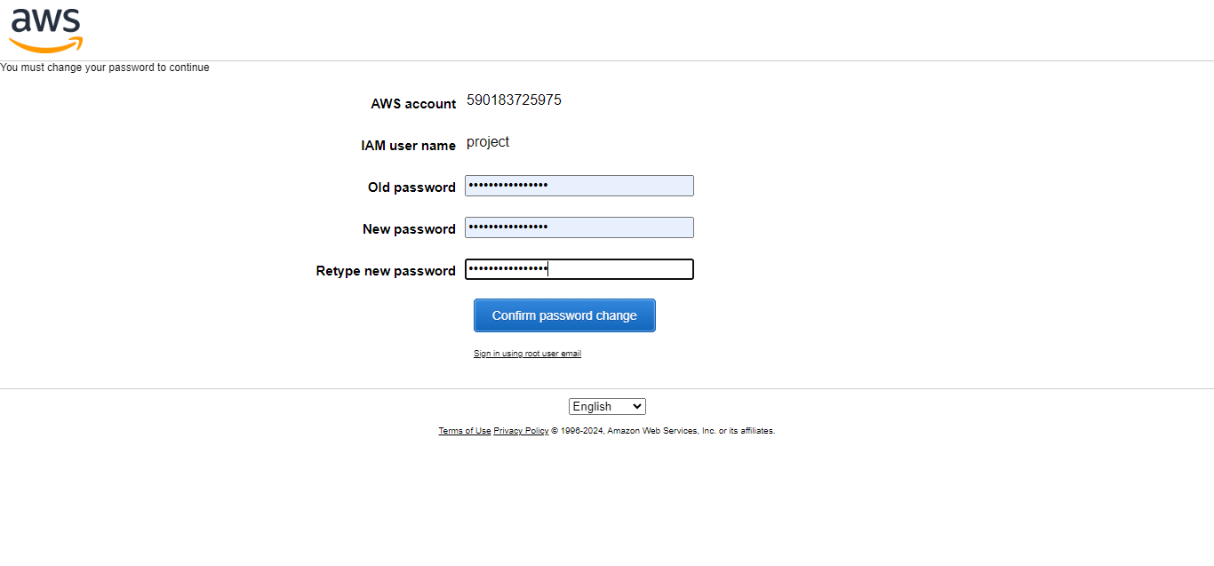

Slide 14
CREATE S3 BUCKETS

Slide 15
An Amazon S3 bucket is a public cloud storage resource available in Amazon Web Services (AWS) Simple Storage Service (S3) platform. It provides object-based storage, where data is stored inside S3 buckets in distinct units called objects instead of files.

Slide 16
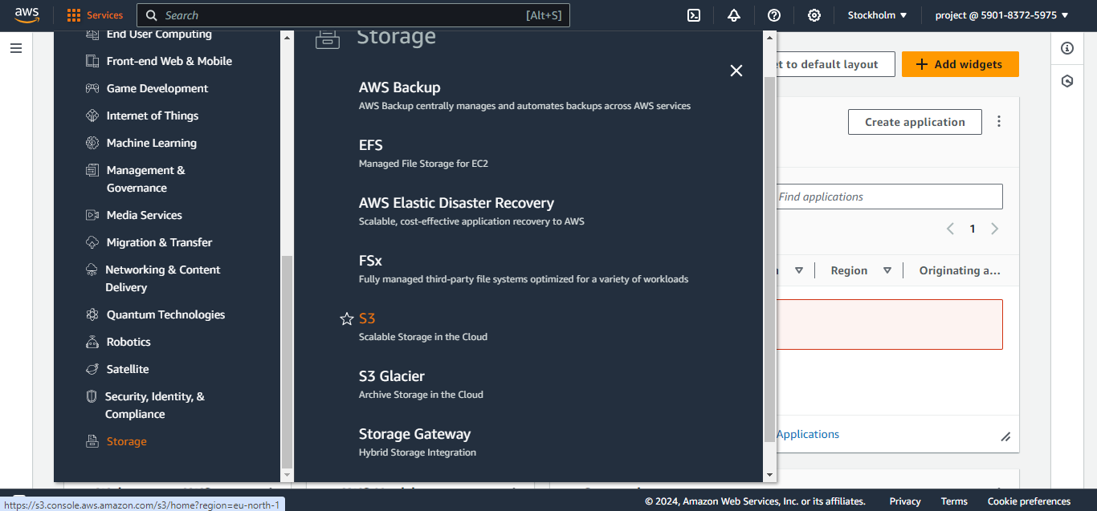

Slide 17
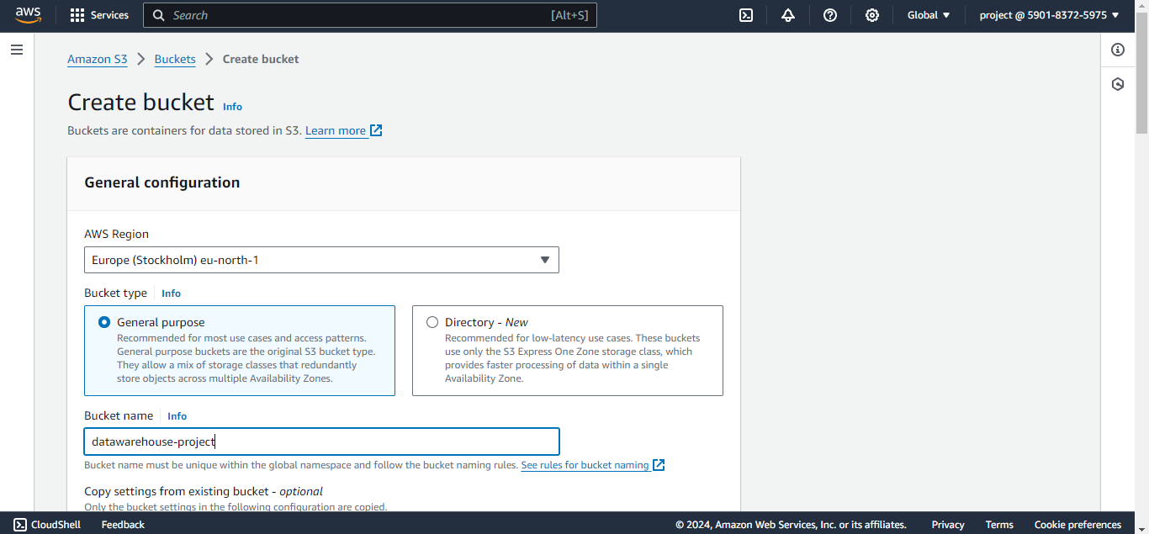

Slide 18
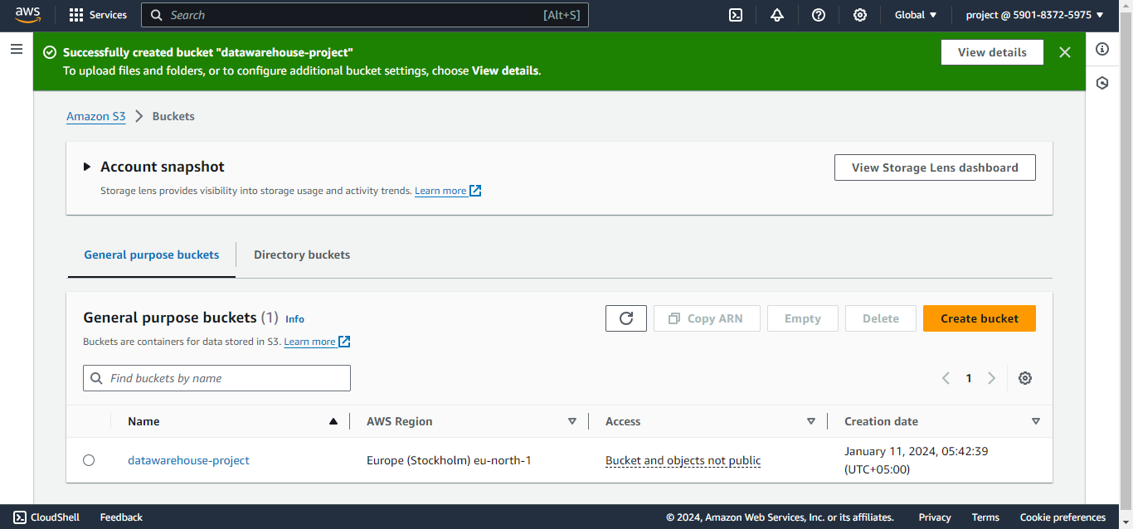

Slide 19
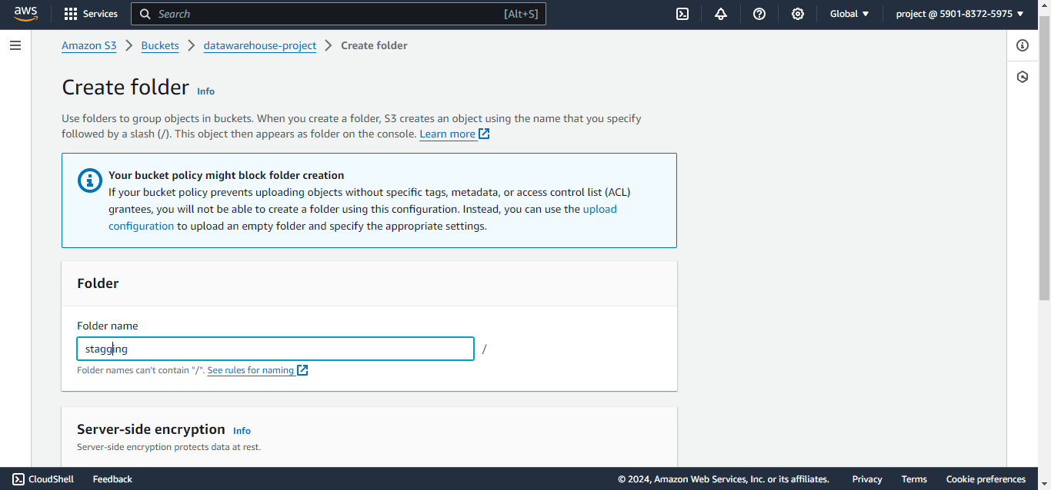

Slide 20
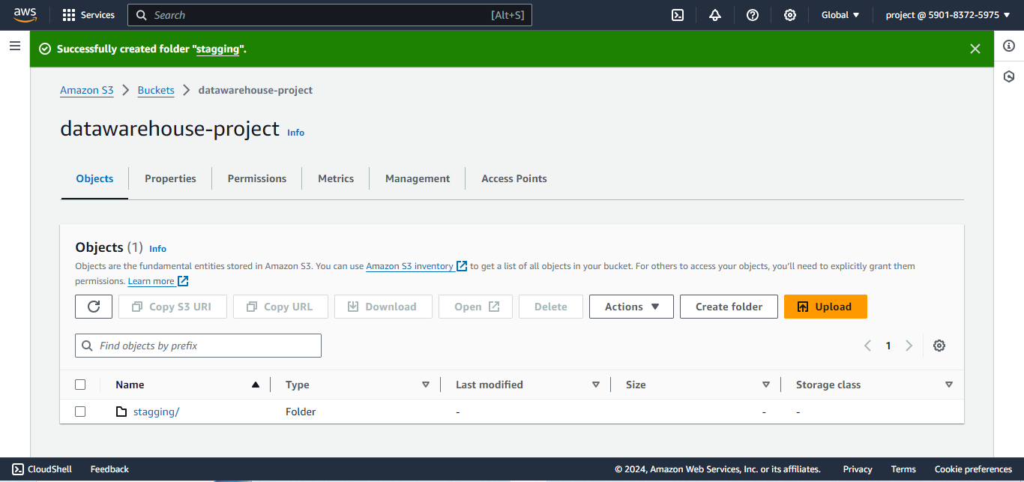

Slide 21
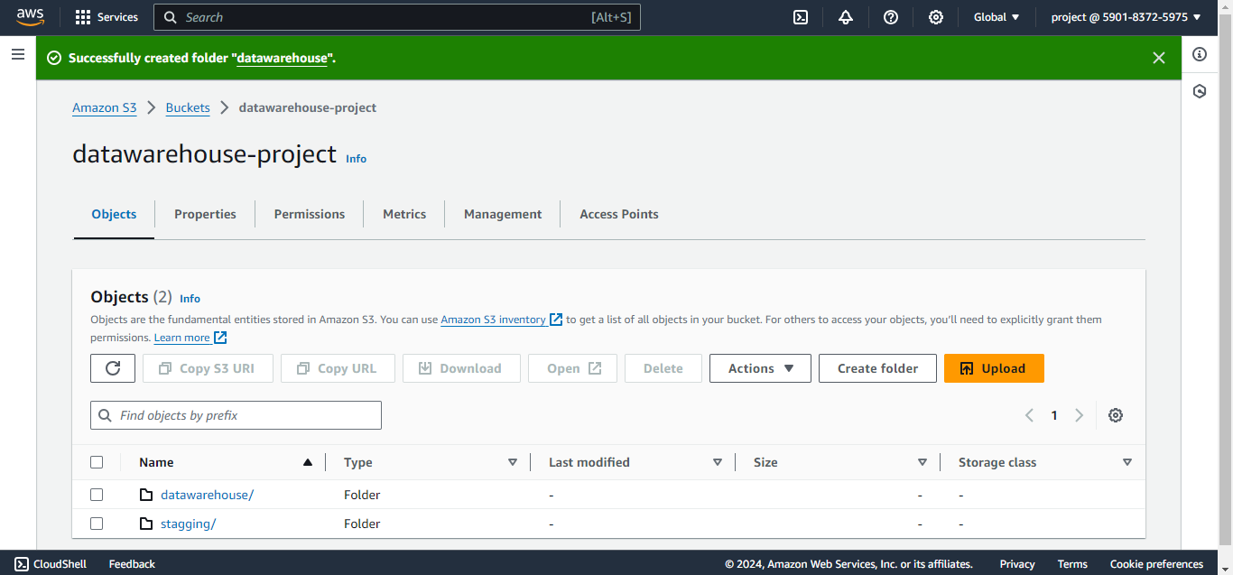

Slide 22
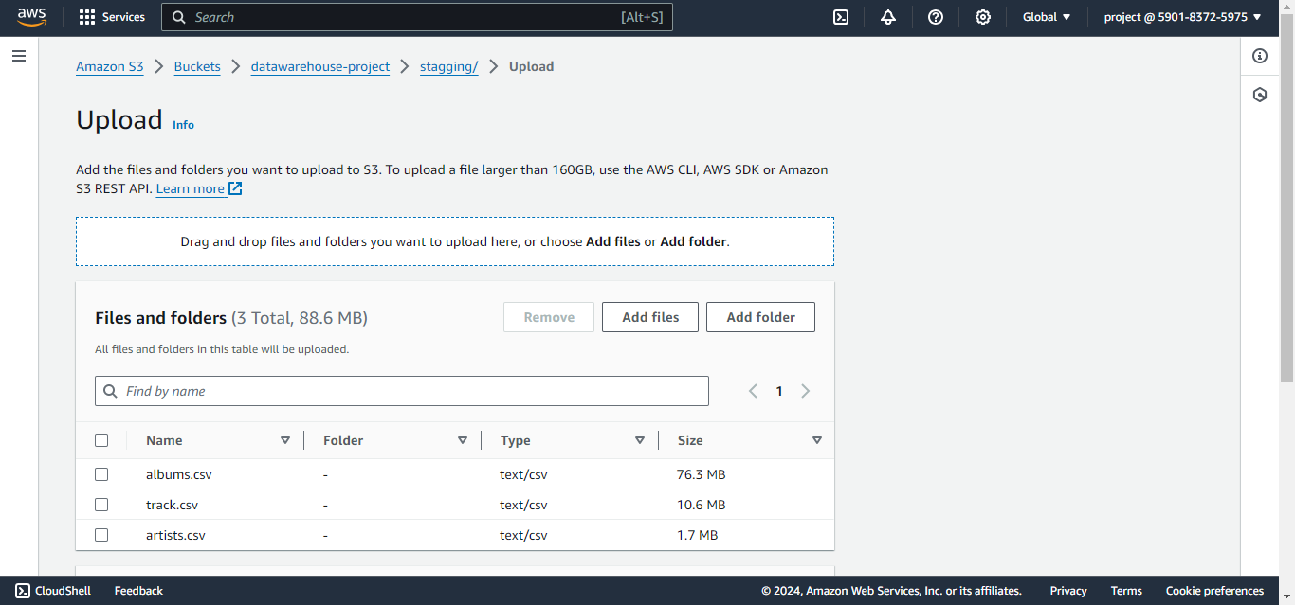

Slide 23
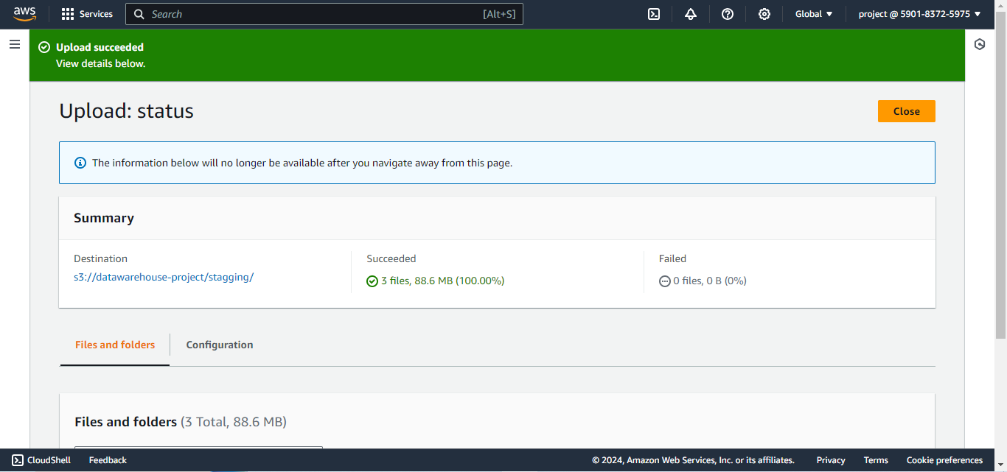

Slide 24
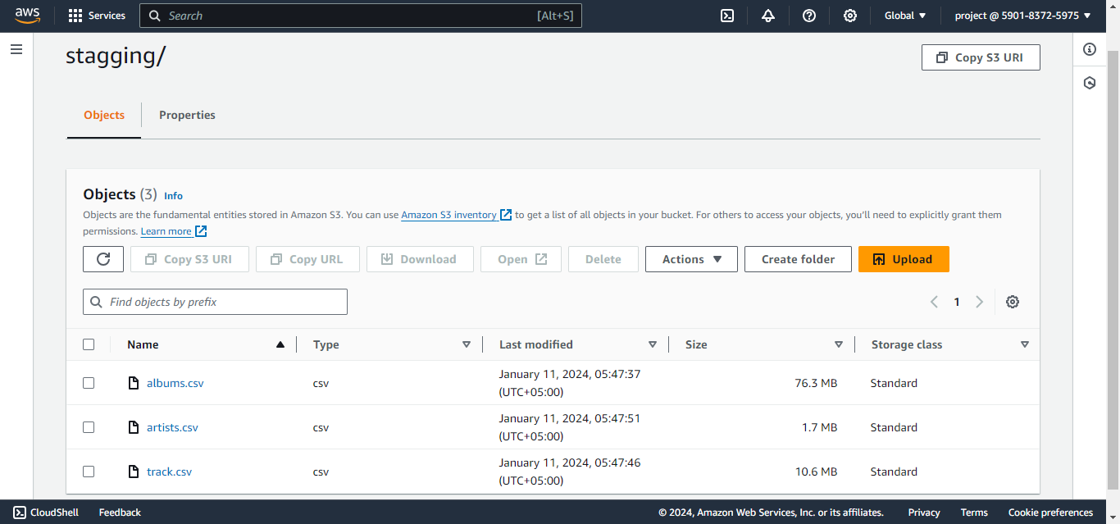

Slide 25
AWS GLUE

Slide 26
AWS Glue provides both visual and code-based interfaces to make data integration easier. Users can more easily find and access data using the AWS Glue Data Catalog. Data engineers and ETL (extract, transform, and load) developers can visually create, run, and monitor ETL workflows in a few steps in AWS Glue Studio.

Slide 27
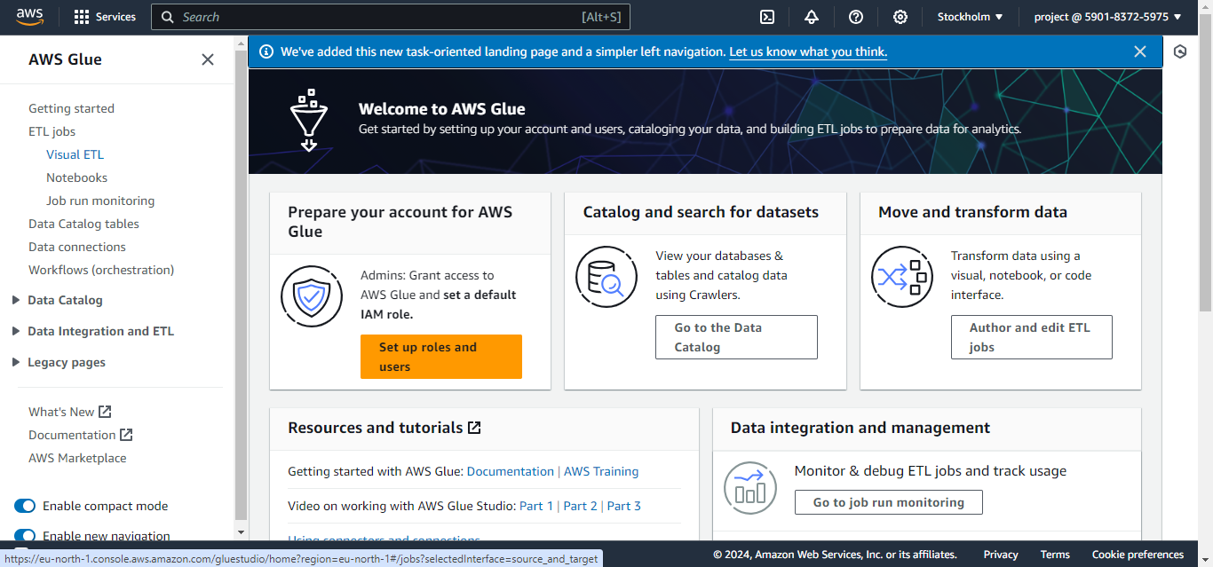

Slide 28
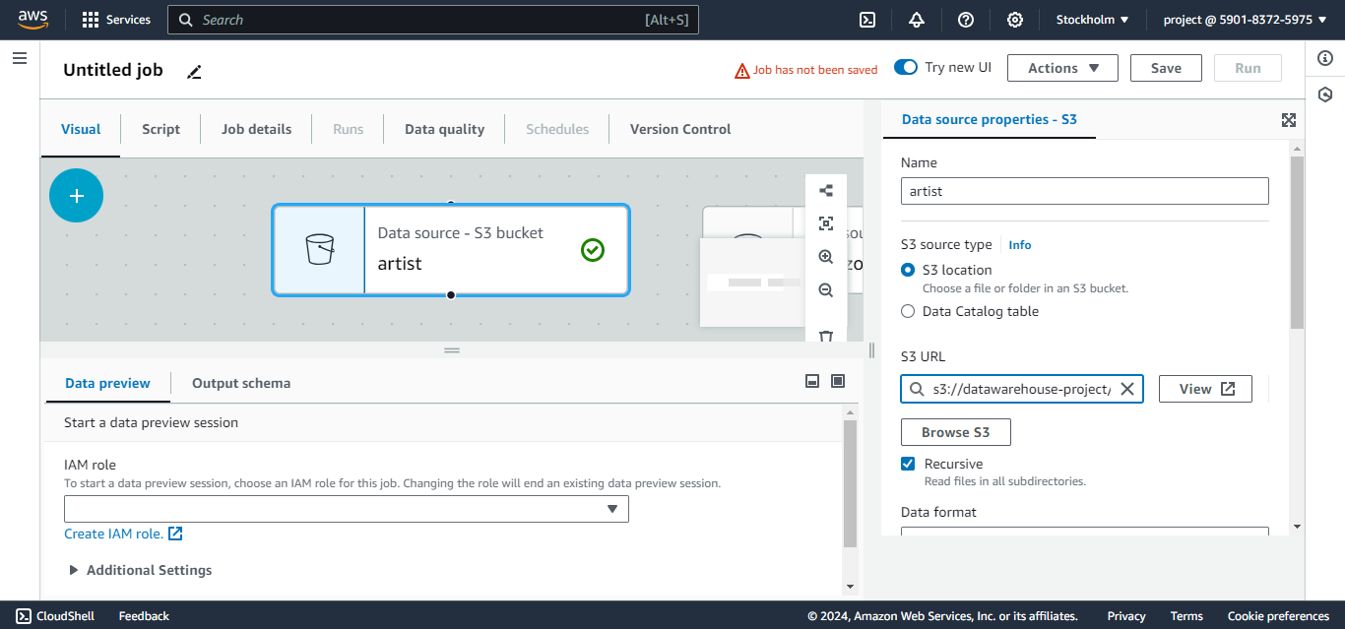

Slide 29
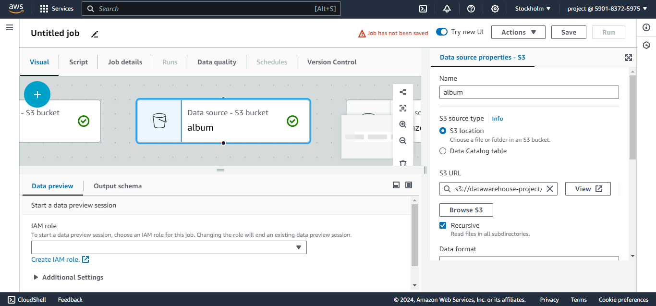

Slide 30
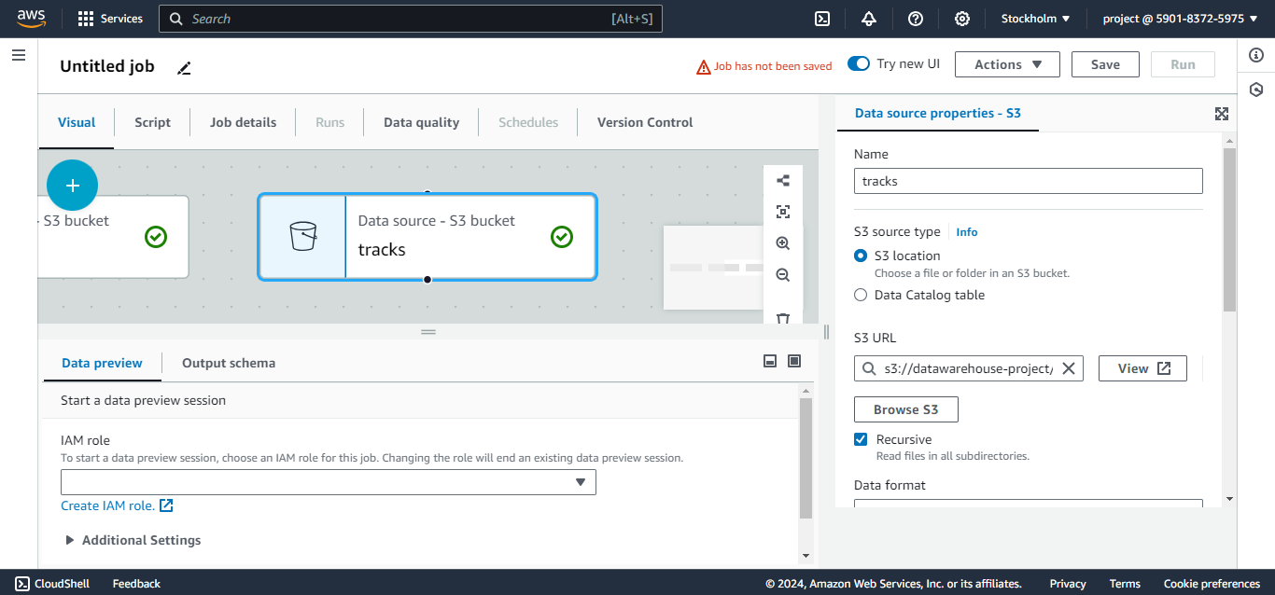

Slide 31
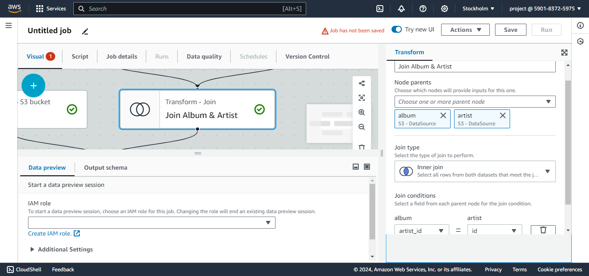

Slide 32
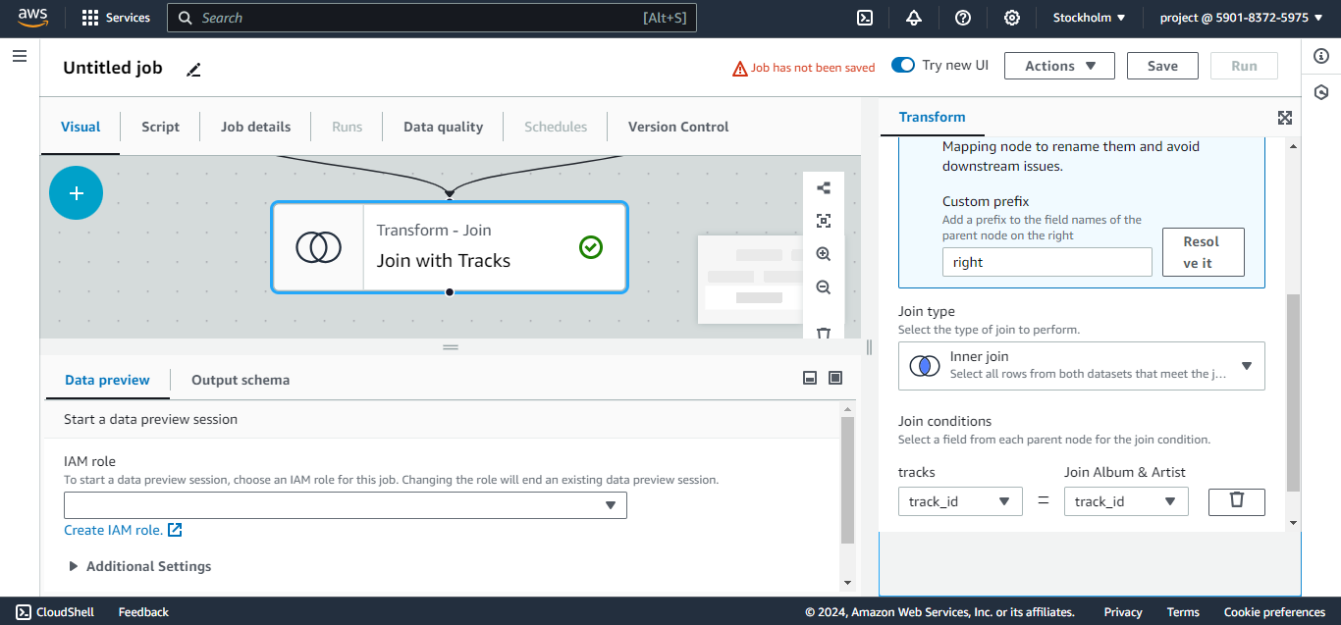

Slide 33
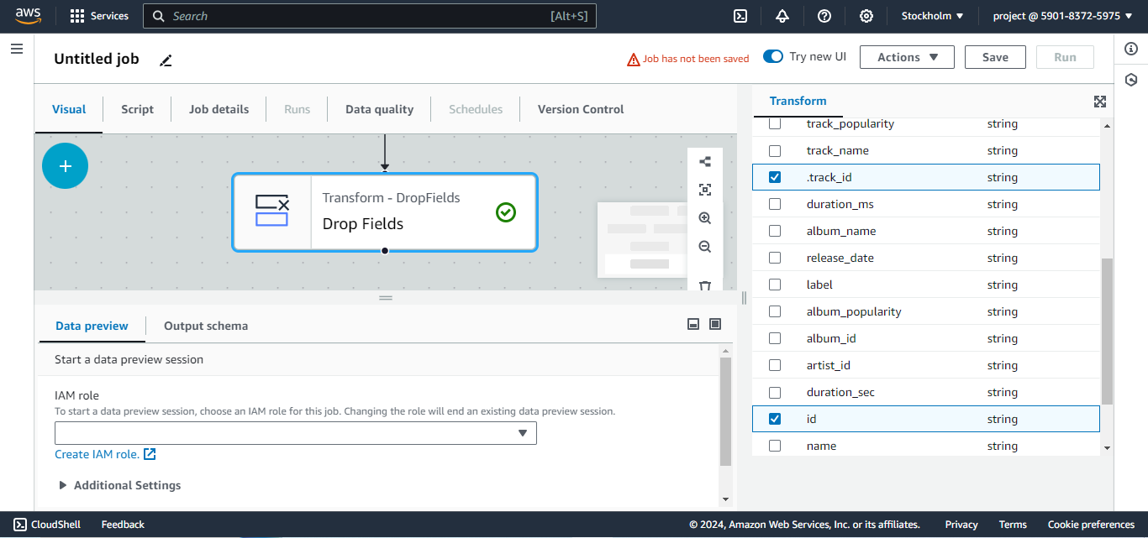

Slide 34
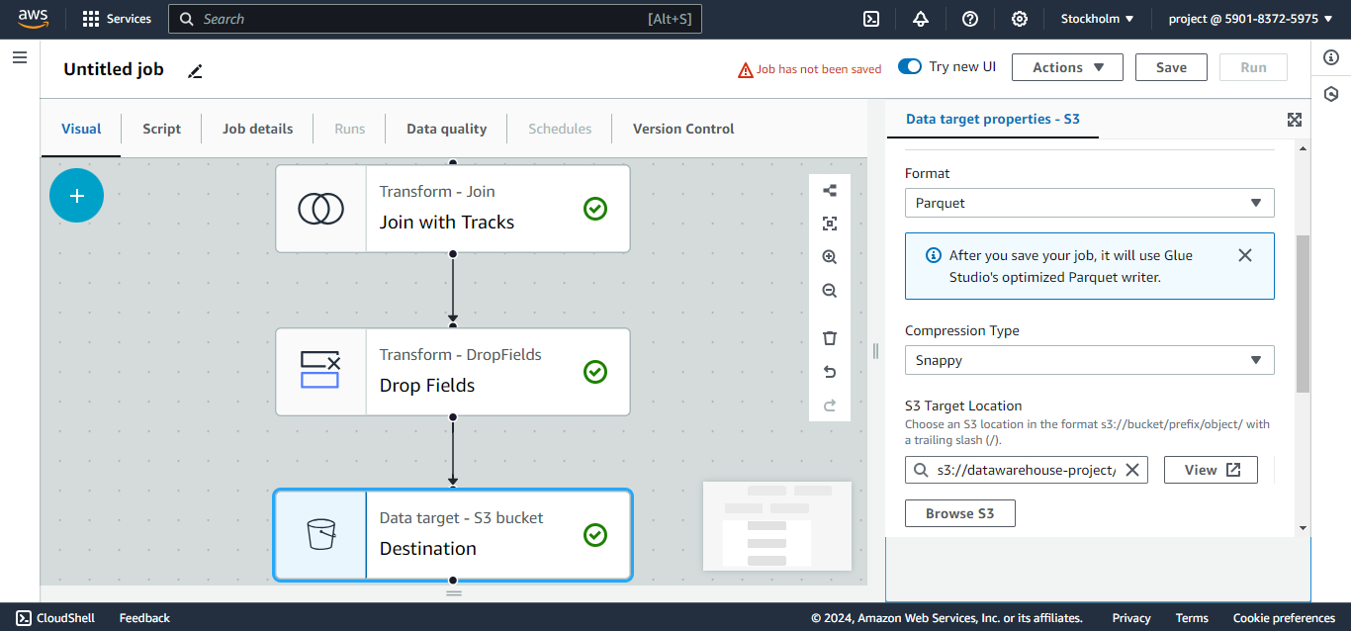

Slide 35
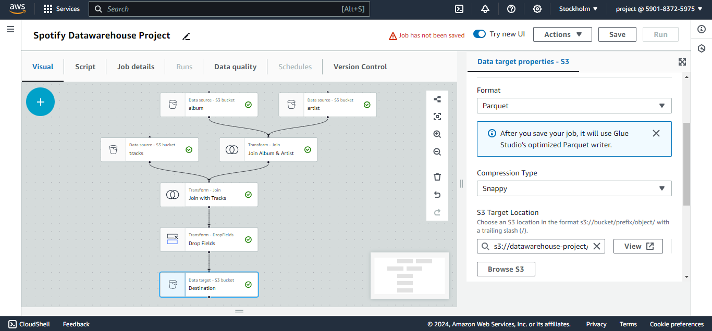

Slide 36
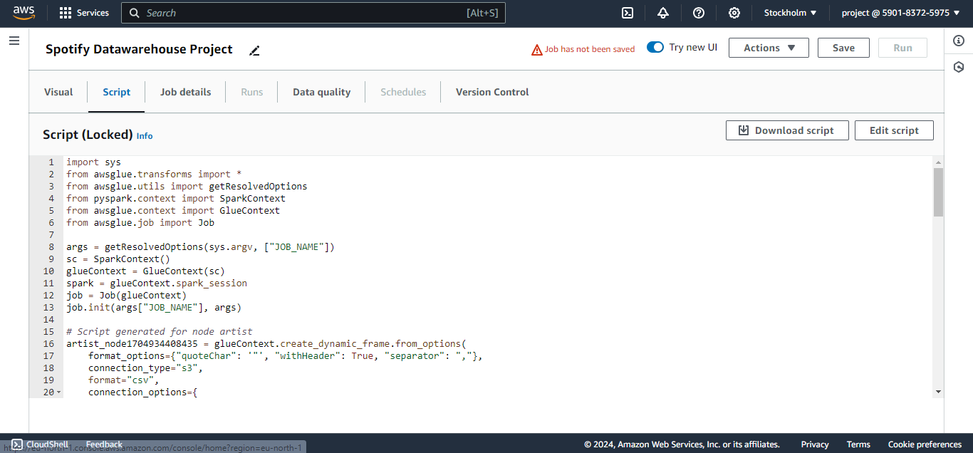

Slide 37
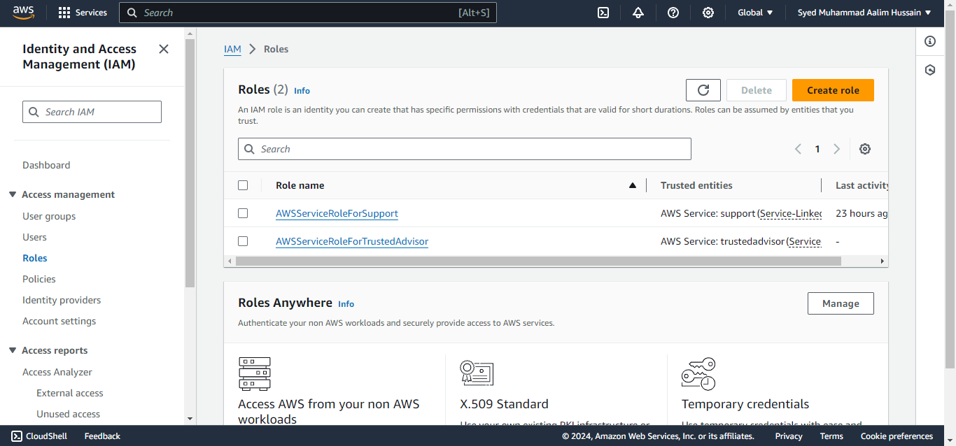

Slide 38
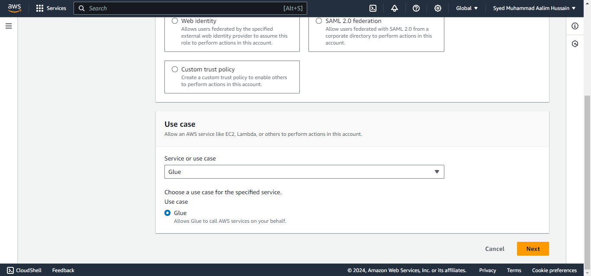

Slide 39
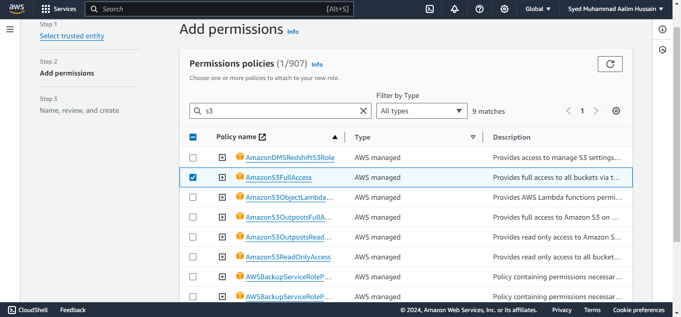

Slide 40
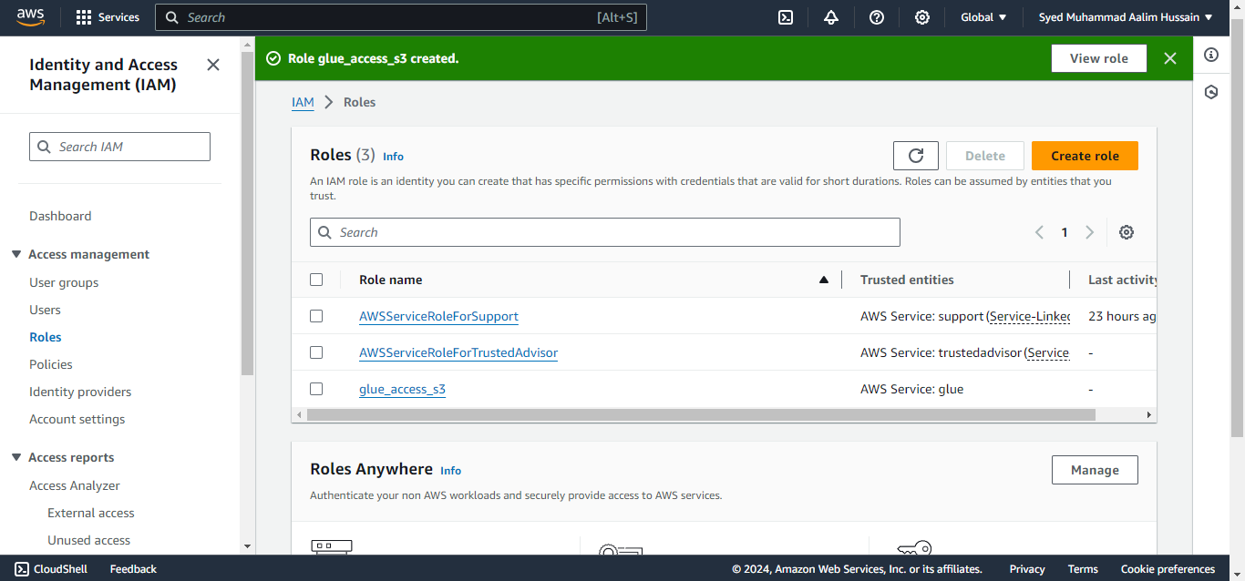

Slide 41
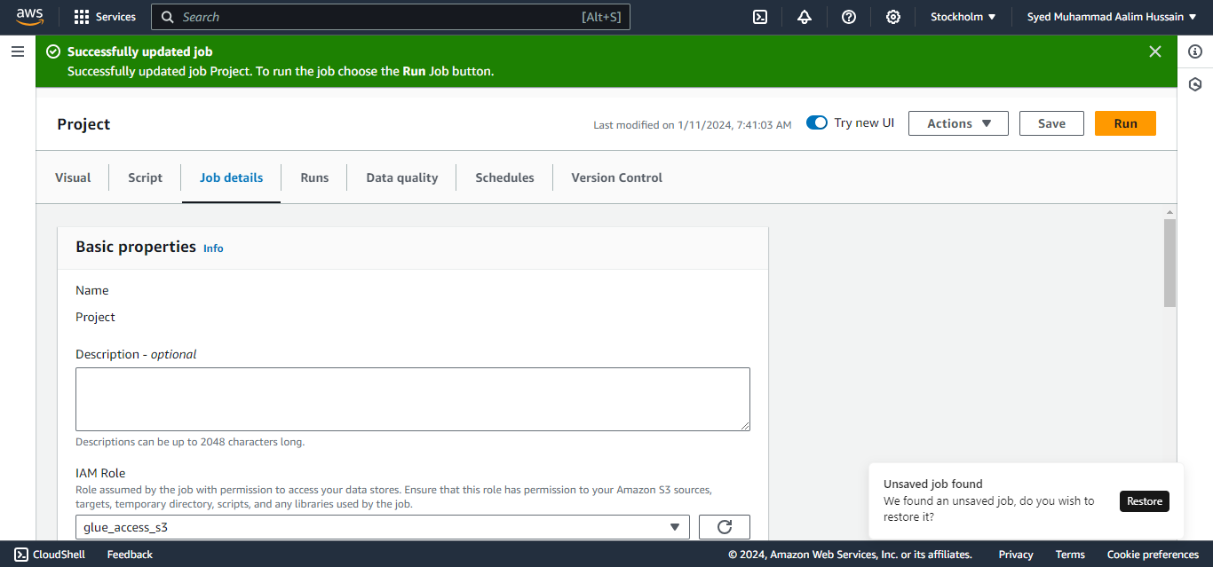

Slide 42
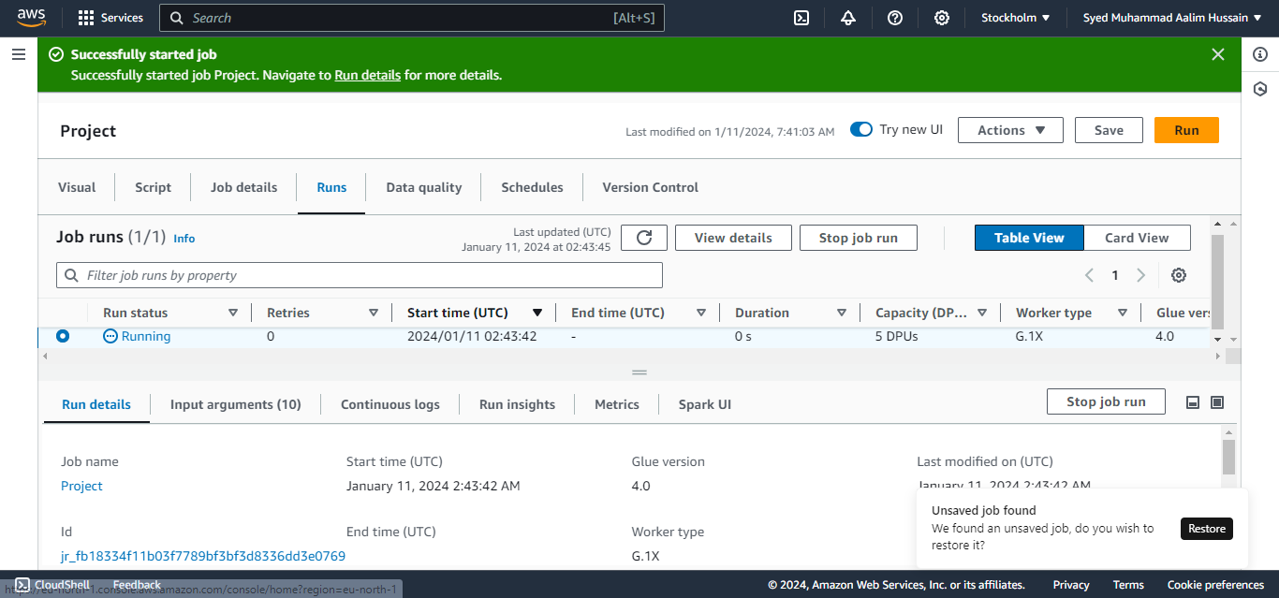

Slide 43
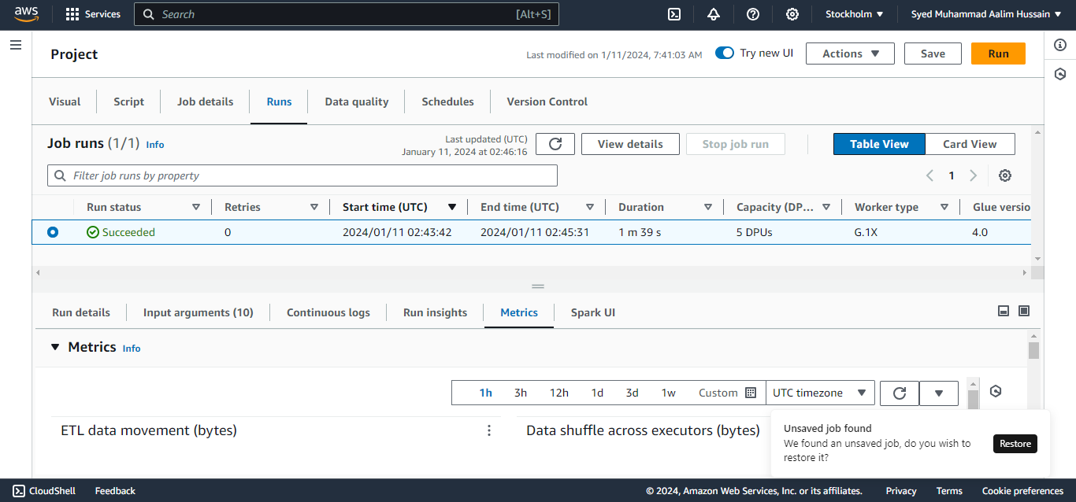

Slide 44
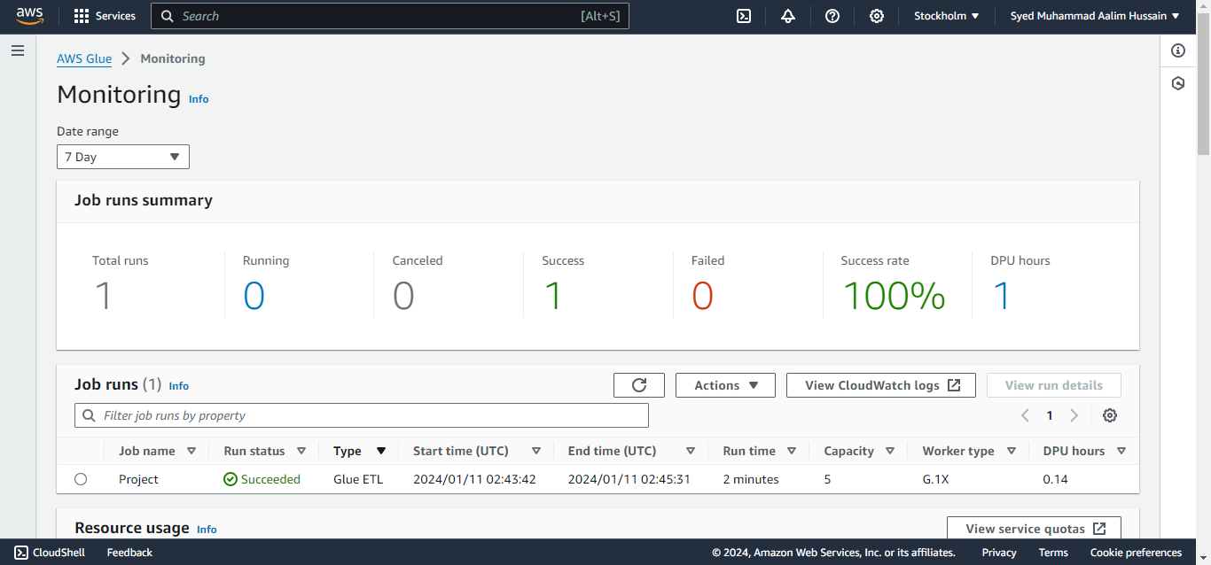

Slide 45
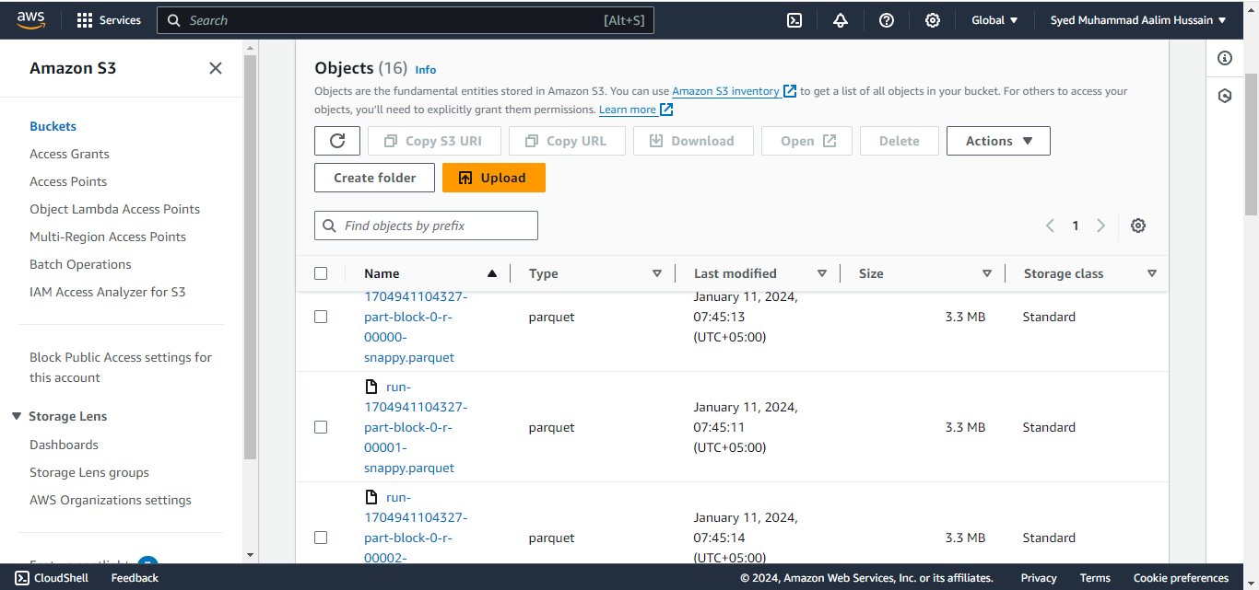

Slide 46
AWS GLUE CRAWLER

Slide 47
The CRAWLER creates the metadata that allows GLUE and services such as ATHENA to view the S3 information as a database with tables. That is, it allows you to create the Glue Catalog. This way you can see the information that s3 has as a database composed of several tables.

Slide 48
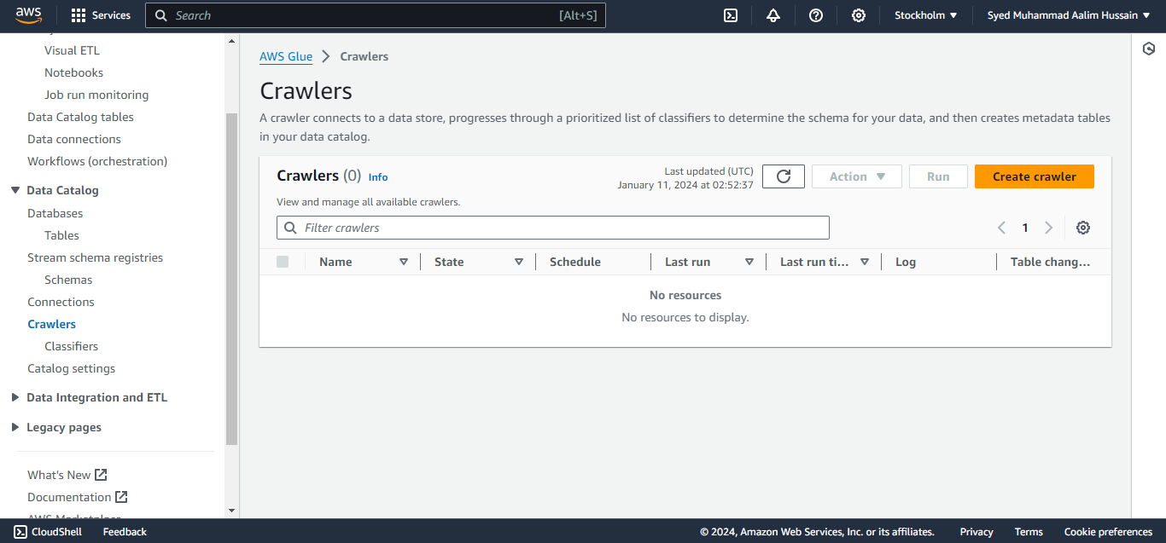

Slide 49
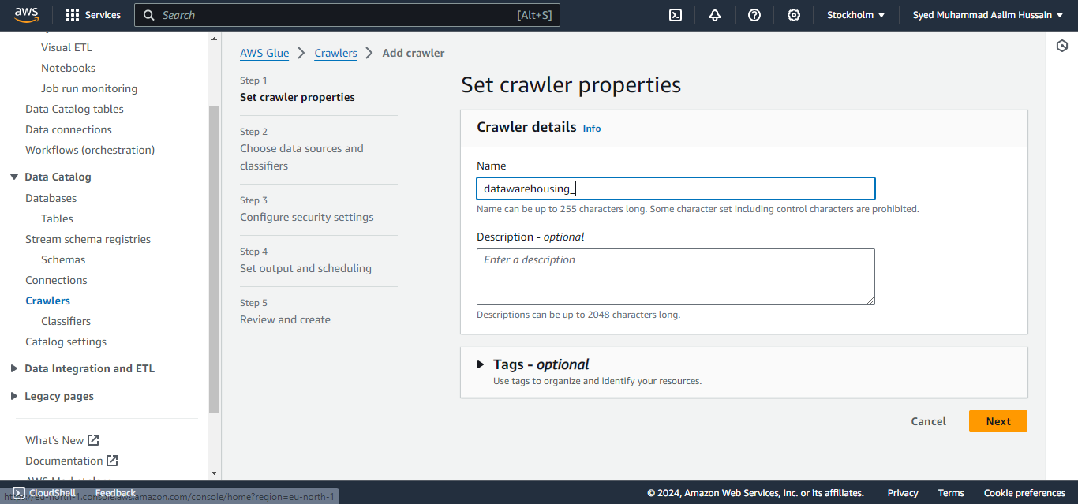

Slide 50
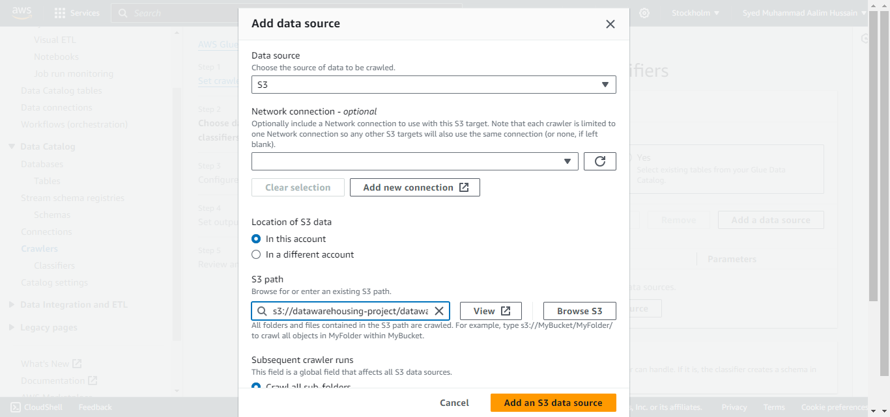

Slide 51
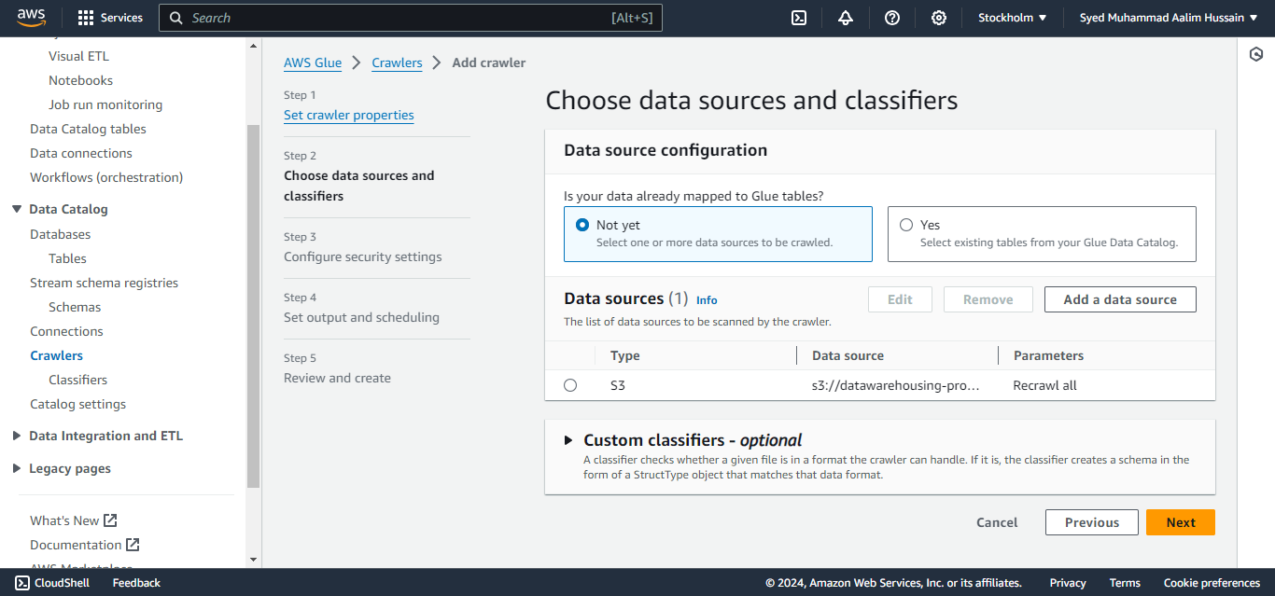

Slide 52
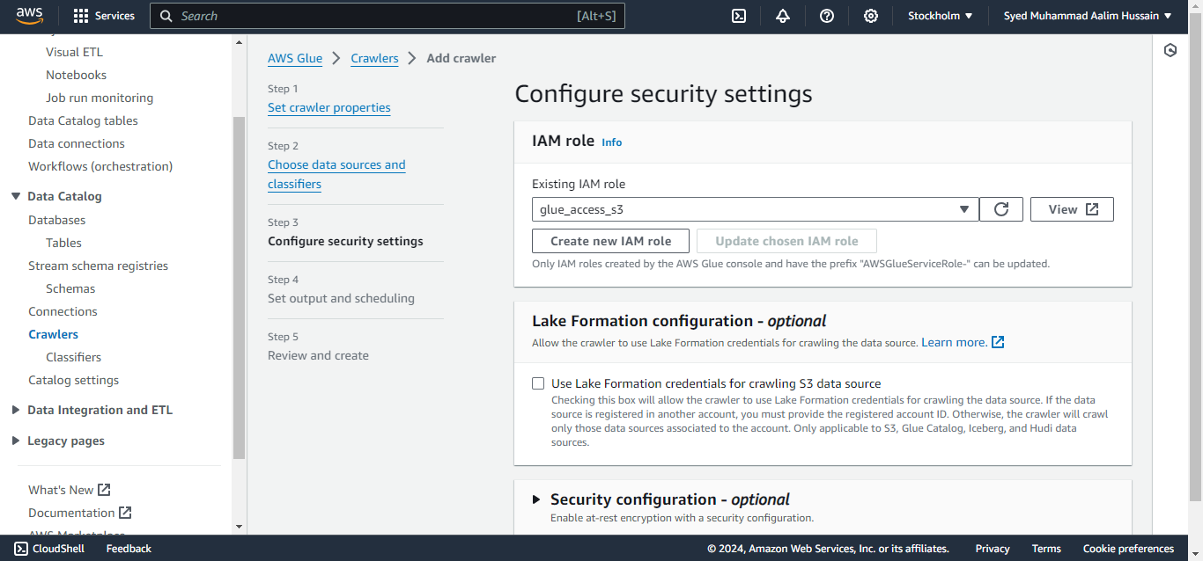

Slide 53
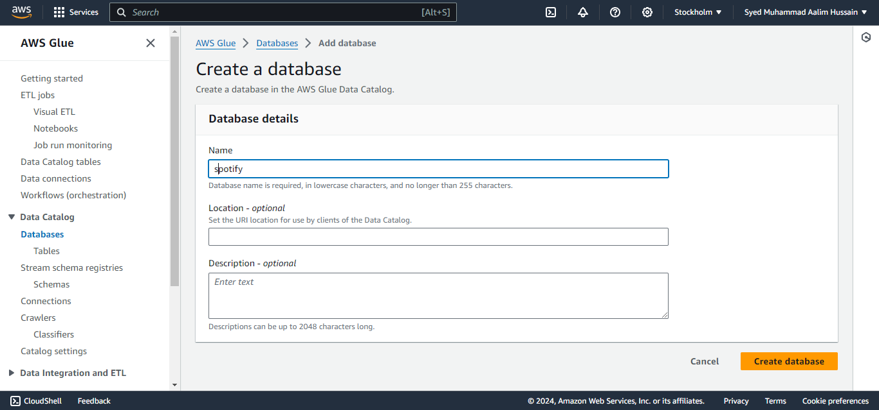

Slide 54
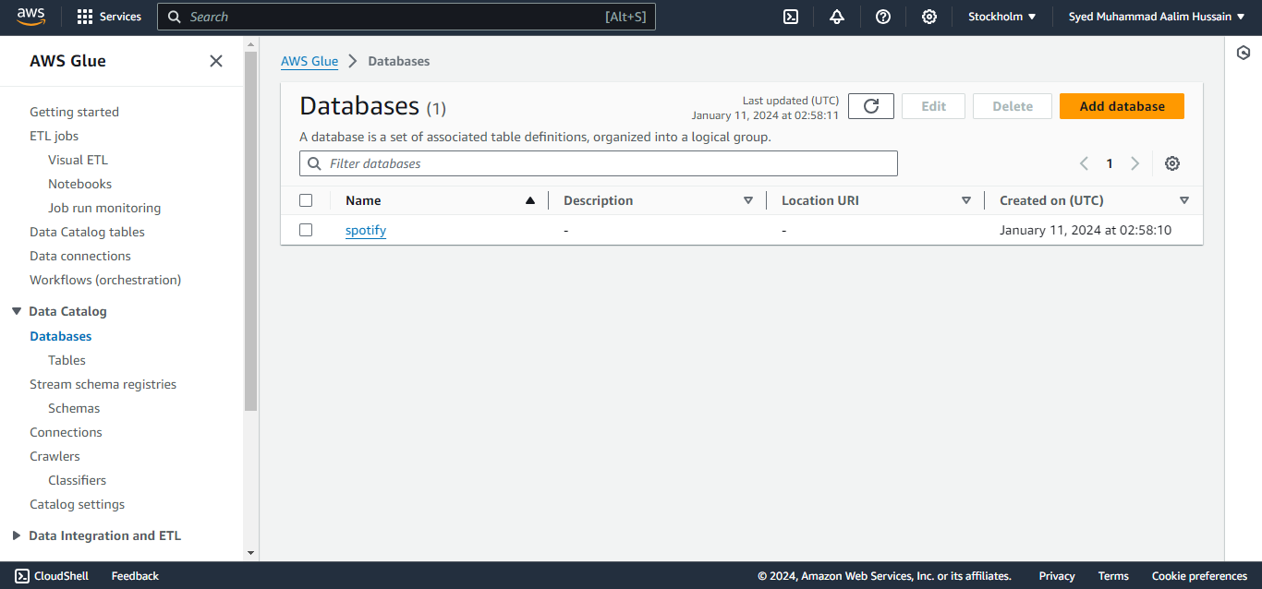

Slide 55
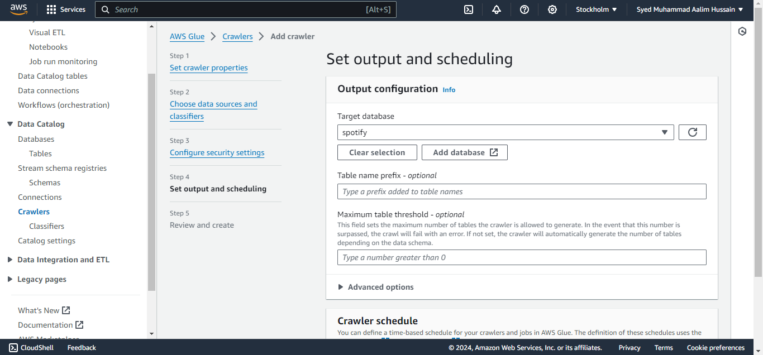

Slide 56
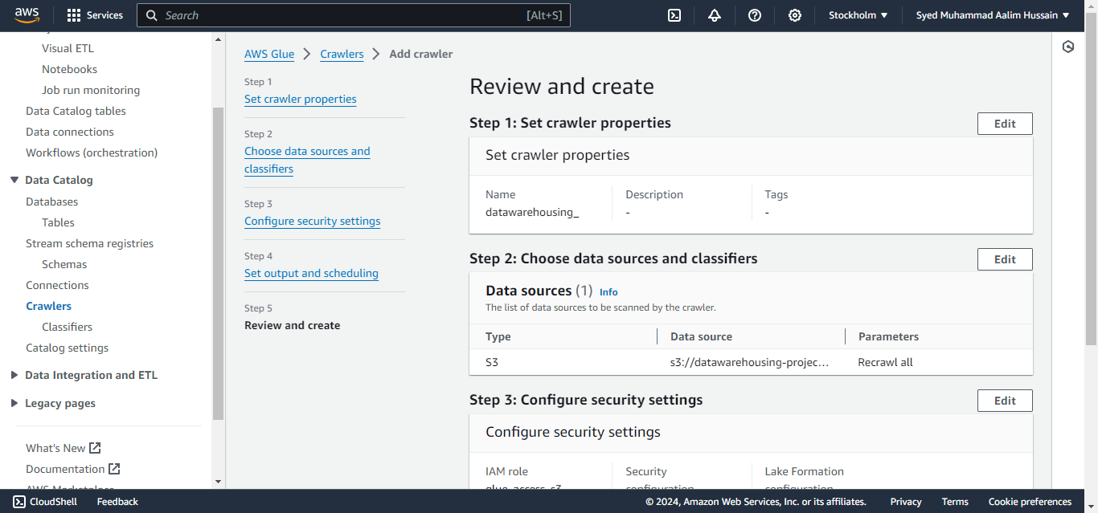

Slide 57
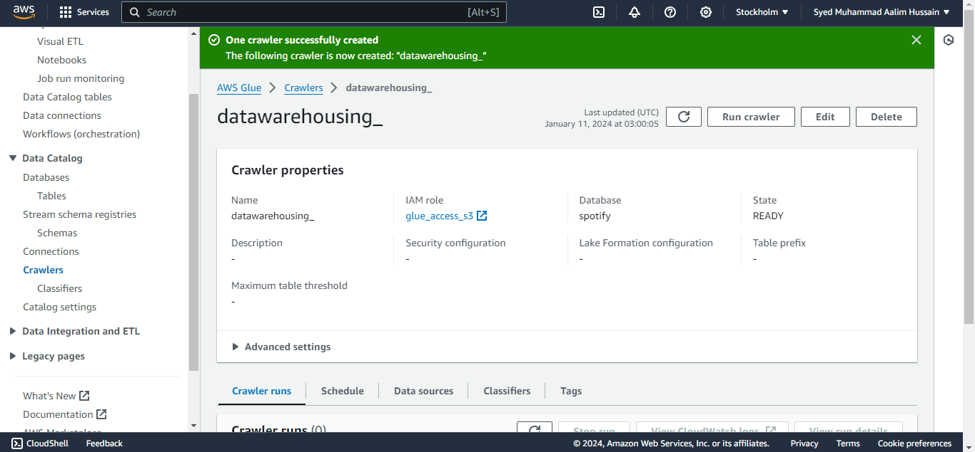

Slide 58
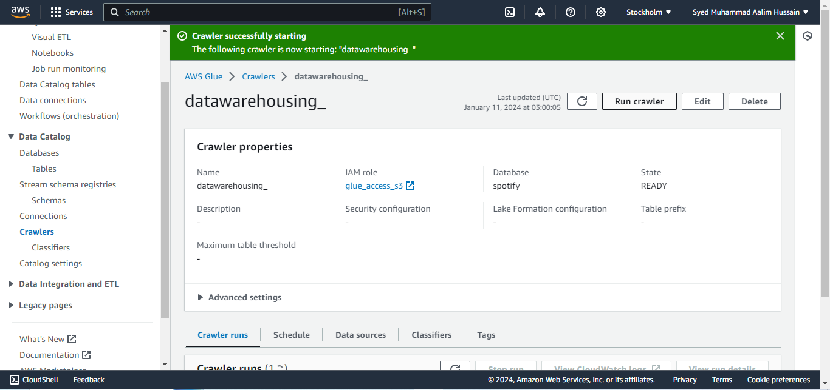

Slide 59
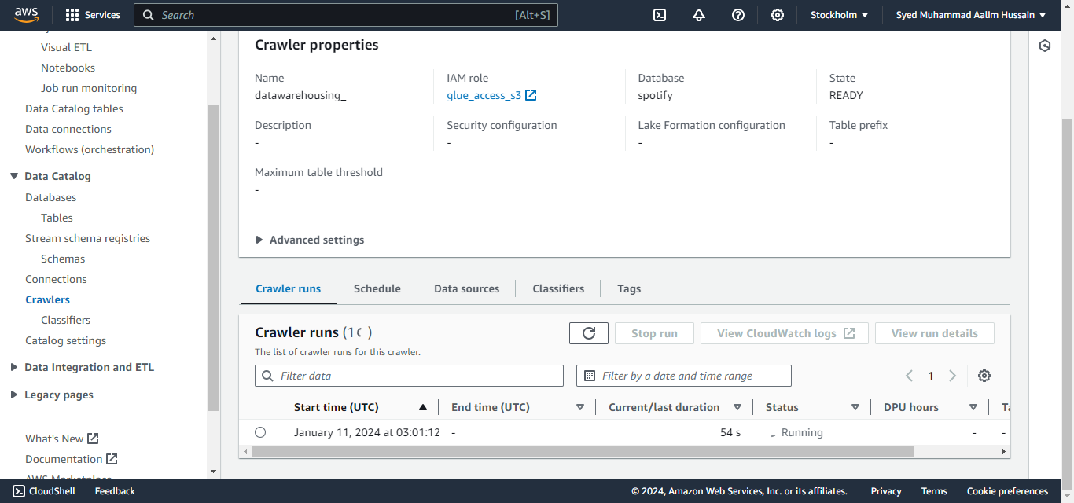

Slide 60
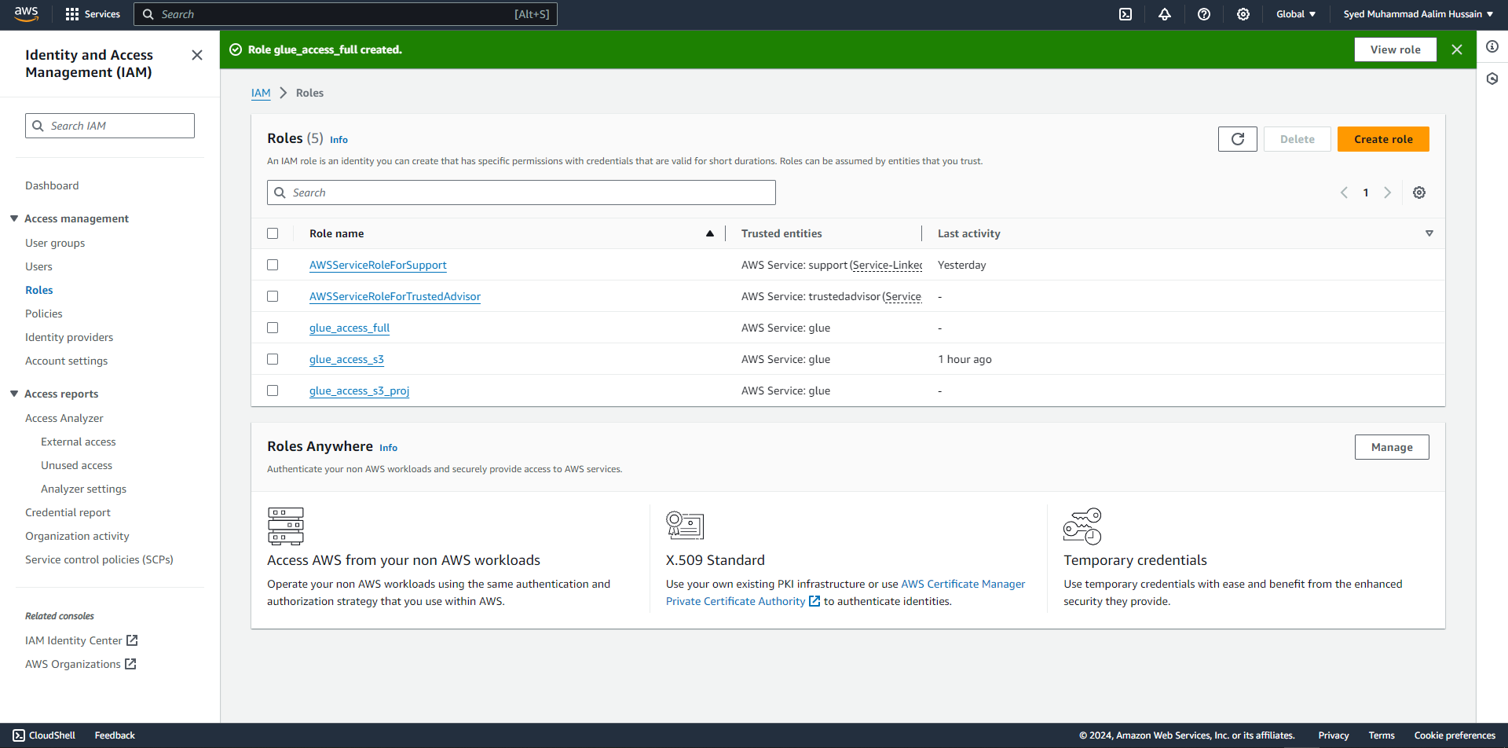

Slide 61
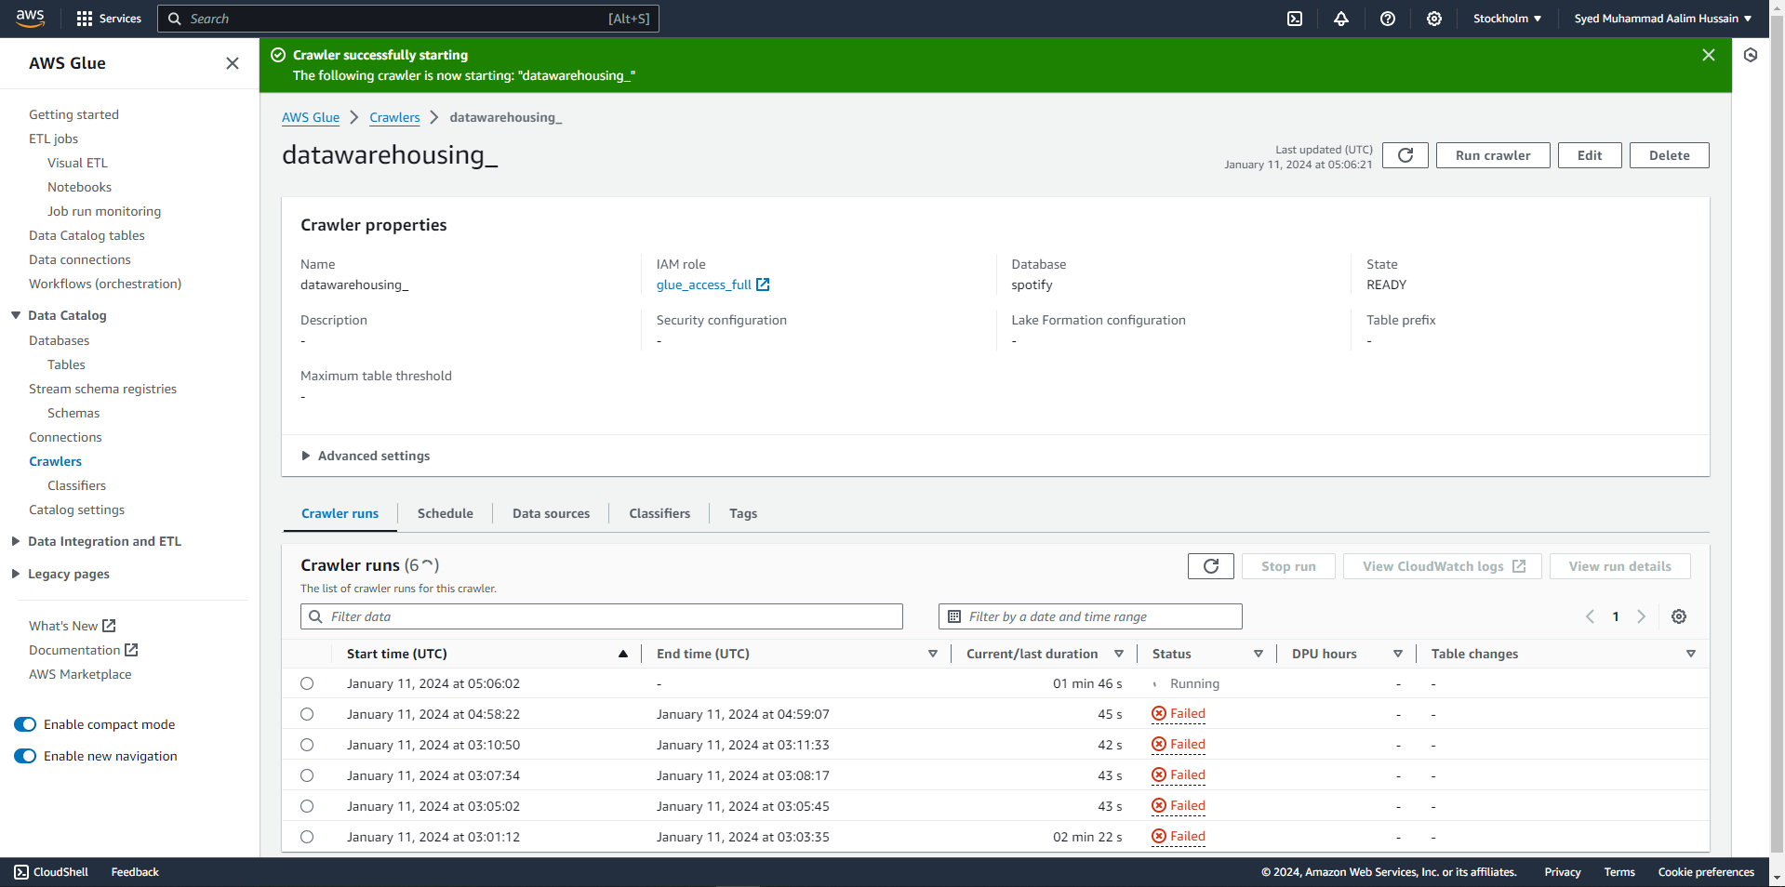

Slide 62


Slide 63


Slide 64


Slide 65


Slide 66


Slide 67


Slide 68


Slide 69
ATHENA

Slide 70
Amazon Athena is an interactive query service that makes it simple to analyze data directly in Amazon S3 using standard SQL. Athena is server less, so there is no infrastructure to setup or manage, and you can choose to pay based on the queries you run or compute needed by your queries.

Slide 71


Slide 72


Slide 73


Slide 74


Slide 75


Slide 76


Slide 77


Slide 78


Slide 79


Slide 80


Slide 81


Slide 82
QUICKSIGHT

Slide 83
QuickSight is a fast, easy-to-use, cloud-powered business analytics service that makes it easier for all employees within an organization to build visualizations, perform ad-hoc analysis, and quickly get business insights from their data, anytime, on any device.

Slide 84


Slide 85


Slide 86


Slide 87


Slide 88


Slide 89


Slide 90


Slide 91


Slide 92


Slide 93


Slide 94


Slide 95


Slide 96


Slide 97
THANK YOU!

